Slide 1
Constructor Injection with Collection(Set) having Dependent Object
We can inject the dependency by constructor.
The <constructor-arg> sub-element of <bean> is used for constructor injection.
We can inject
primitive and String-based values
Dependent object (contained object)
Collection values etc.

Slide 2
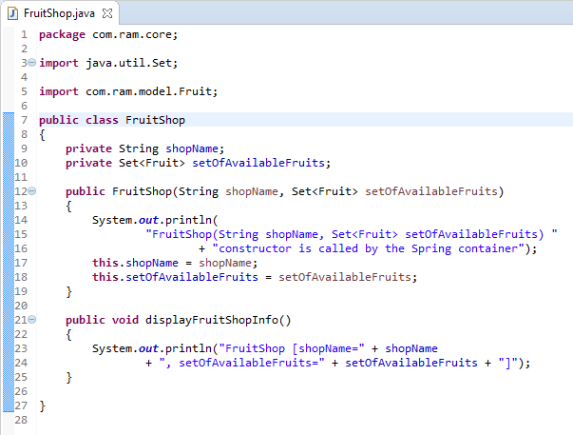
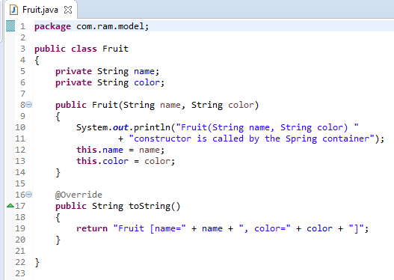
Constructor Injection with Collection(Set) having Dependent Object

Slide 3
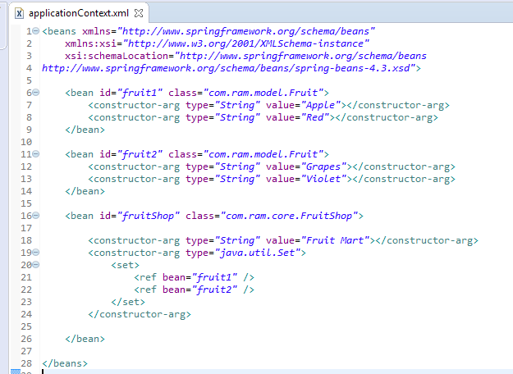
Constructor Injection with Collection(Set) having Dependent Object
We are providing the information into the bean by applicationContext.xml file.
The constructor-arg element invokes the constructor.The type attributes specifies that String, Set parameter constructor will be invoked. In this example FruitShop(String shopName, Set<Fruit> setOfAvailableFruits) constructor will be invoked.
The set element of constructor-arg is used here to define the set.
The ref element is used to define the reference of another bean. Here, we are using bean attribute of ref element to specify the reference of another bean

Slide 4
Constructor Injection with Collection(Set) having Dependent Object
FruitShop
What object to instantiate?
What object to configure and how to configure?
The Spring Container
(ApplicationContext)
applicationContext.xml
FruitShop
Object
shopName=Fruit Mart,
listOfAvailableFruits=
[Fruit [name=Apple, color=Red],
Fruit [name=Grapes, color=Violet]]
Create the FruitShop object.
Configure the FruitShop object.
Manage FruitShop object complete life cycle from creation till destruction.

Slide 5
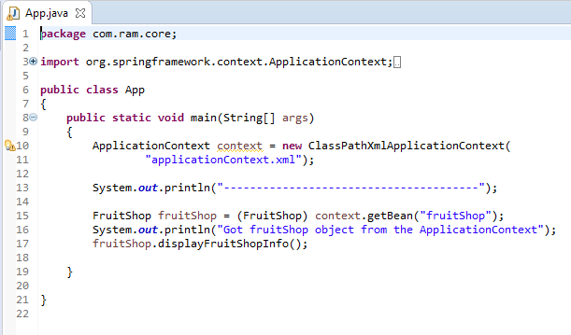
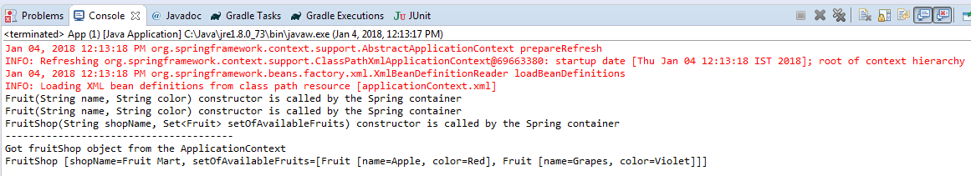
Constructor Injection with Collection(Set) having Dependent Object

